Slide 1

092020 Appathon
Antonios Valmas 03116134

Slide 2
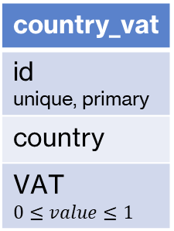
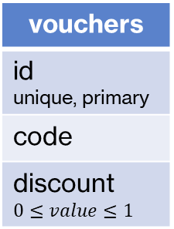
Database models
orders
id unique, primary
voucher_id foreign key
username foreign key
country_vat_id foreign key
vouchers
id unique, primary
code
discount $$0≤value≤1$$
users
username unique, primary
fullName
password
birthday
country_vat
id unique, primary
country
VAT $$0≤value≤1$$
products
id unique, primary
name
image
price
Order_items
id unique, primary
order_id foreign key
product_id foreign key
quantity foreign key

Slide 3
Database seeding
Users table: Data are added through the registration form
Orders/Order items table: Data are added through the purchase functionality
Country vat/vouchers: Data must be added by user manually (through phpMyAdmin)
Products: Import functionality is only available for admin (user with username admin)
A products.csv must be added under the directory specified in import-products.jsp
Format:
Id {integer} The product id. Must be unique
Name {String} The product's name. Cannot be more than 200 characters
Image {URL} The product's image. Can be a url, or a local path (relative or absolute)
price {Double} The product's price without VAT

Slide 4
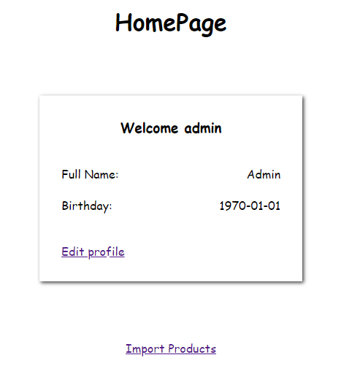

Access Import Products
To import new products you need the products.csv as described in the previous slide
The functionality can be accessed through the myhomepage page. (A link will appear for the user with username “admin”)
After clicking it a message will appear notifying the user about the status of the import

Slide 5
Project’s Architecture
Project is mainly based on JSP
All database models have a class representation for easier data manipulation
Basket page:
Voucher functionality has been implemented with a Servlet
(POST voucher code => Returns a number from 0 to 1 which is the discount)
Country Vat functionality has been implemented with a JSP
(GET country vat list => Returns the list of countries and their VATs)

Slide 6
Session
The holds the following information:
user: The User instance that corresponds to the logged in user.
username: Used for registration page to autofill username field after an unsuccessful login
cart: A TreeMap<Integer, Integer> holding the products ids and their quantities the user has added to their cart.
voucher: The Voucher instance that corresponds to the voucher the user used. (Purchase can be processed with a null voucher)
A user can logout from the app to clear their session.

Slide 7
Logging in\Registration
Login Page (localhost:8080/Appathon/):
The user can log in by providing their credentials
If the user submits an incorrect password an error message appears
If the user submits a non-existing username the get redirected to registration page where the username field is pre-filled
Registration Page (localhost:8080/Appathon/newuser/)
The user can register to the app by providing username, fullName, password and date of birth.

Slide 8
HomePage
HomePage (localhost:8080/Appathon/myhomepage):
In the homepage the user can see their information (not their password)
They can update their information by clicking the link below their information
UpdatePage (localhost:8080/Appathon/pageupdate)
The user can update their full name or the date of birth. (the field are already pre-filled with their current information)

Slide 9
ProductsPage
ProductsPage (localhost:8080/Appathon/producs)
The user can see the available producs
By hovering over the price they can see the price with VAT for each product
By pressing the Add to cart button they can the product to their cart

Slide 10
Basket Page
Basket Page (localhost:8080/Appathon/basket):
The user can see the products they have added to your cart
The user can see the total, vat, discount and final total of their order
The user can add a voucher code which applies a discount to the products
The use can choose their country from the list of countries to apply the proper VAT (by default the first country is selected)

Slide 11
Purchasing
After placing a order the order is saved in the database along with the order items (thing the user bought)
A order_<order_id>.txt is created in the path specified in OrderServlet.java with the below format:
User <username> submitted an order with <vat>% vat
[They used the voucher <vouchercode> for a <voucherdiscount> % discount]*
Order Items:
<quantity of 1st item>x of product with id <product id>
<quantity of 2nd item>x of product with id <product id>
<quantity of 3rd item>x of product with id <product id>

Slide 12
Guarded Routes
All pages except from login and registration are protected.
This means only logged in users can access them
If non logged in user tries to access them they will get redirected to the login page

Slide 13
Thank you for your time

